Slide 1
An Analysis of Airbnb New York

Slide 2
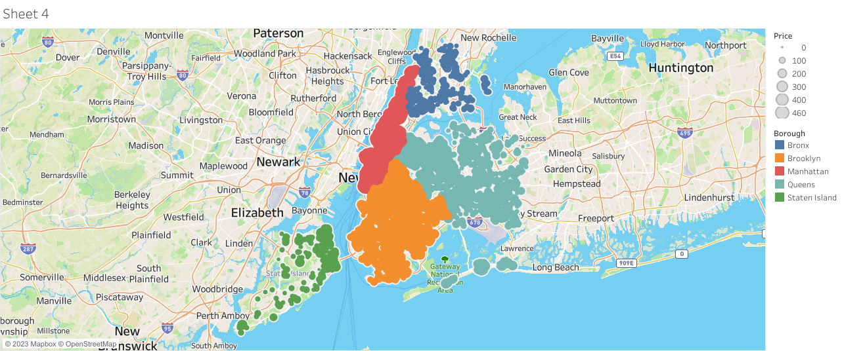
Manhattan has the greatest residential housing stock

Slide 3
Manhattan-expensive among boroughs
For a person to stay for long duration with average prices and calculating distance from the company STATEN ISLAND or QUEENS can be considered
If the company is in MANHATTAN, boroughs with cheaper prices can be considered

Slide 4
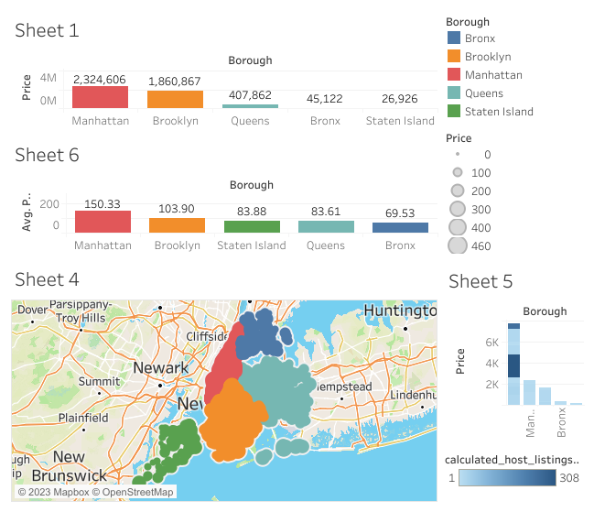
Boroughs Vs Price

Slide 5
Entire home/apt - Most Common room type
71% of the preferred room type is entire home/apt
If an employee from a start up company is travelling alone (i.e.) for solo traveller, shared rooms can be preferred
If an employee travels with family, entire home/apt can be preferred
If the company has average budget, private rooms can be preferred

Slide 6
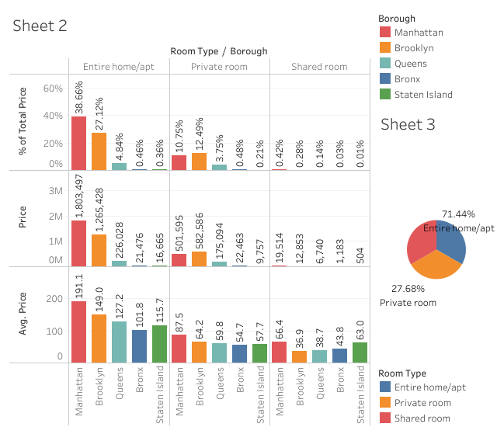
Room Type/Borough Vs Price

Slide 7
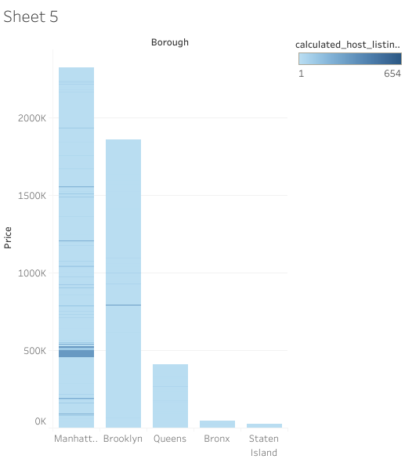
Manhattan has highest revenue with listing
The revenue may differ with room type
But considering the listing MANHATTAN has the highest revenue
Maximum number of properties owned by one host is 327

Slide 8
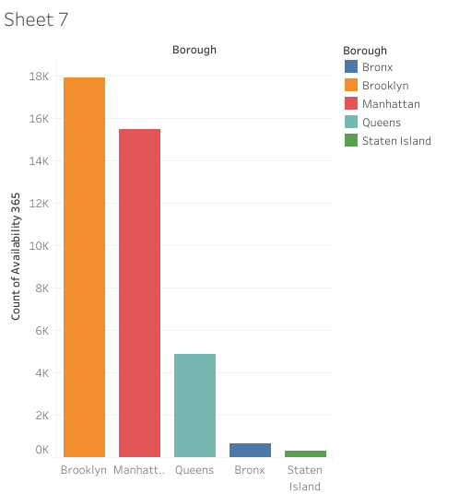
Availability among boroughs
Availability differ among boroughs with BROOKLYN being most available and STATEN ISLAND being least available

Slide 9
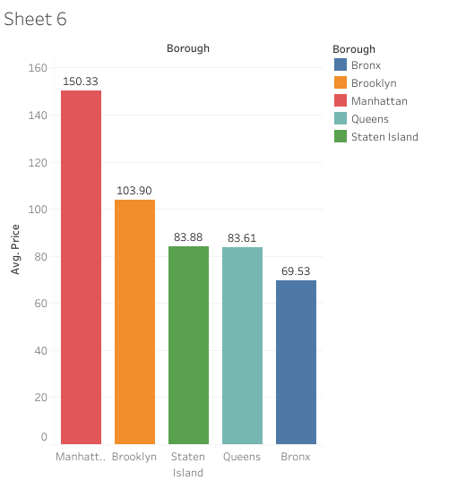
Properties in Manhattan is expensive
The properties in MANHATTAN is most expensive and BRONX is lease expensive
For acquiring, non premium parts can be targeted in expensive areas and affordable premium parts can be prioritized in least expensive areas

Slide 10
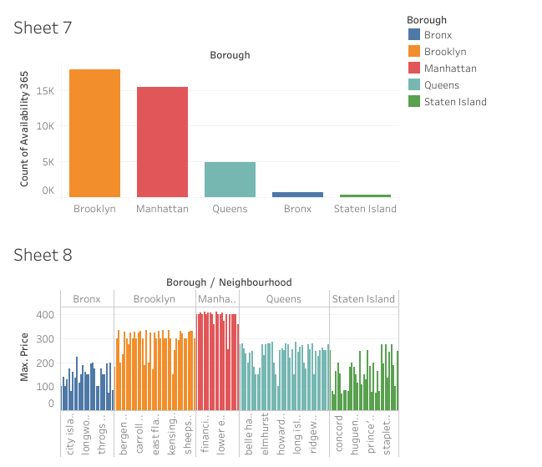
Expensive real estate in NYC Price of residential unit vary by neighbourhood

